Slide 1
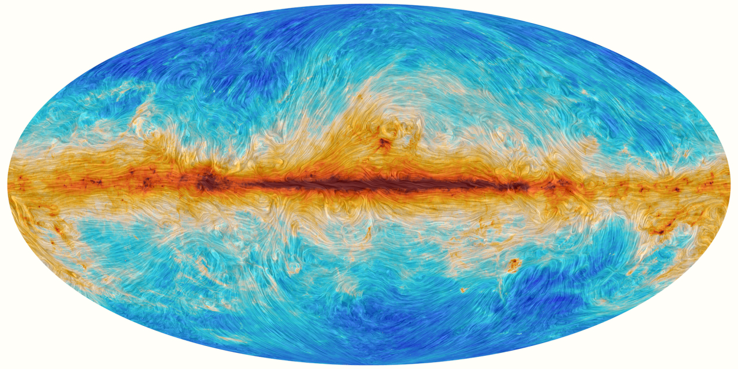
A New Turbulence Measure from Multi-frequency Synchrotron Polarization
Recover the turbulence spectrum and anisotropy from polarization maps without RM synthesis.
We introduce a directional-spectrum measure computed directly from Q and U.
Aliaksandr Melnichenka
Berea College
American Astronomical Society (AAS 247)
January 7, 2026
Phoenix, AZ.
Alex Lazarian (UW Madison)
Dmitry Pogosyan (University of Alberta)
Notes:
Names, conference name
“Imagine recovering the spectrum of interstellar magnetic turbulence from just one polarization map at one radio frequency. No RM synthesis. No wide bandwidth. That’s the core result of our work.”

Slide 2
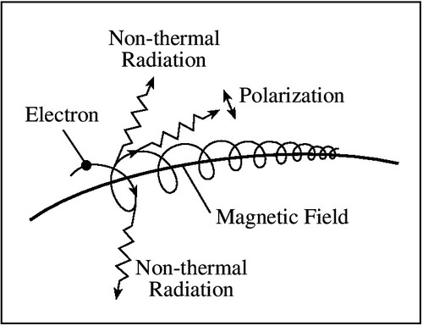
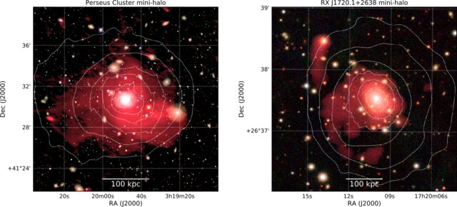
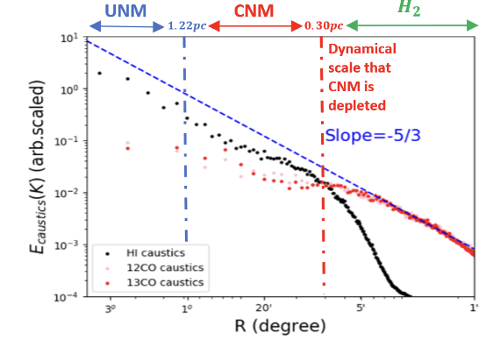
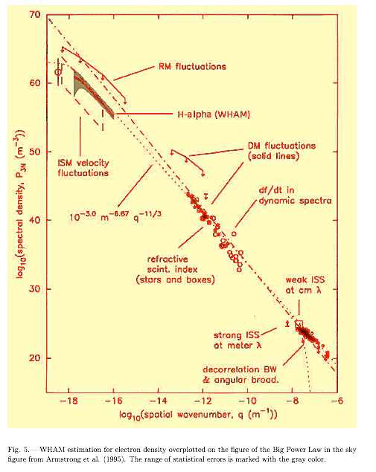
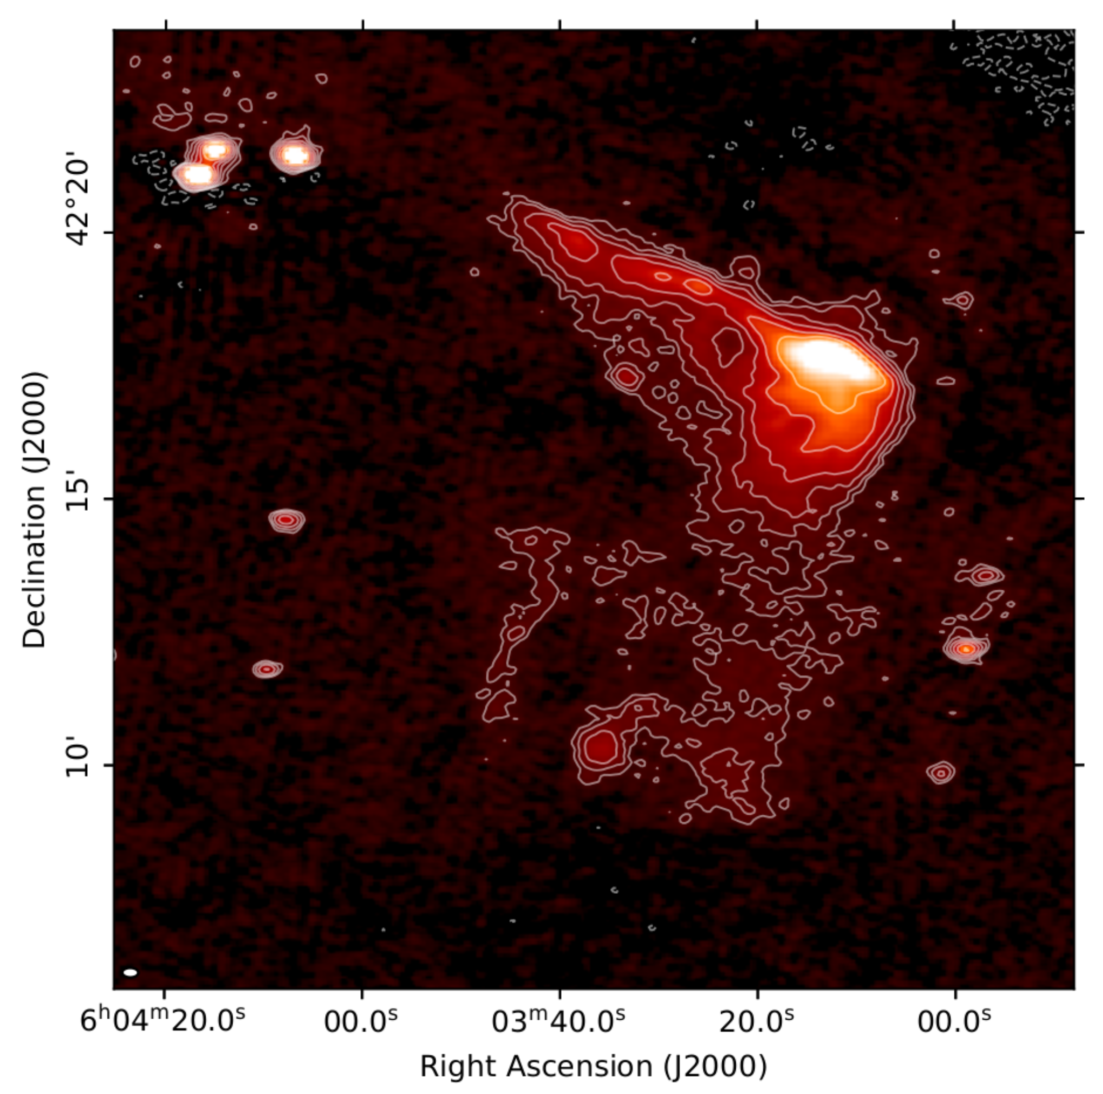
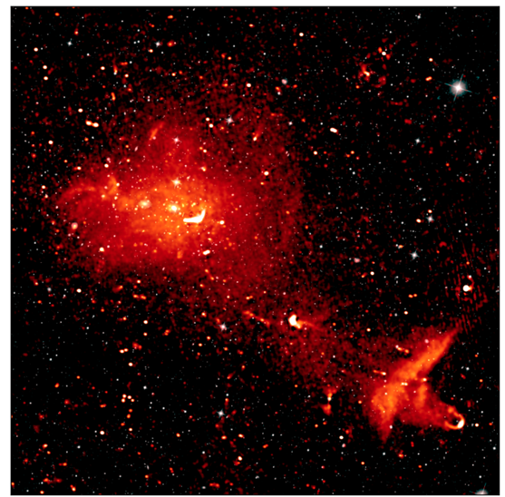
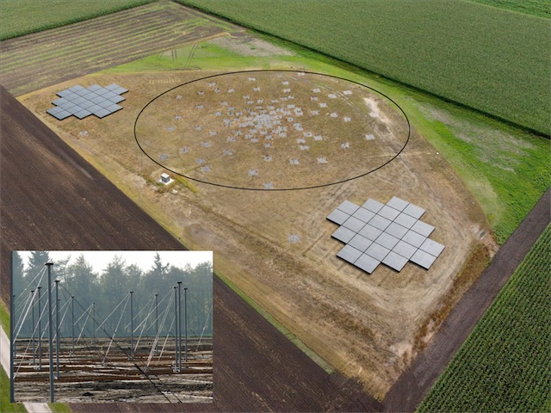
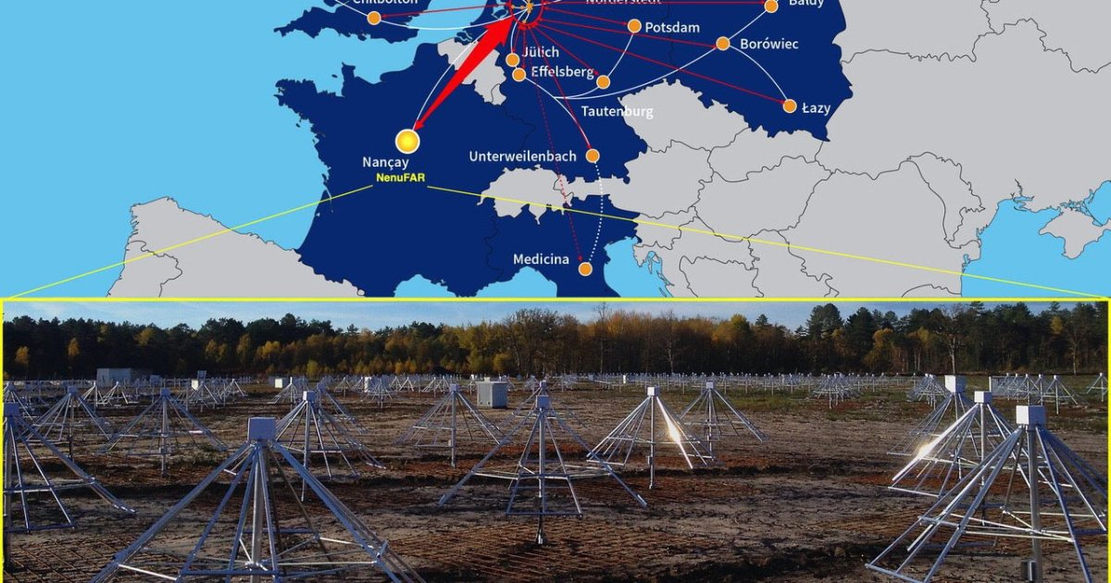
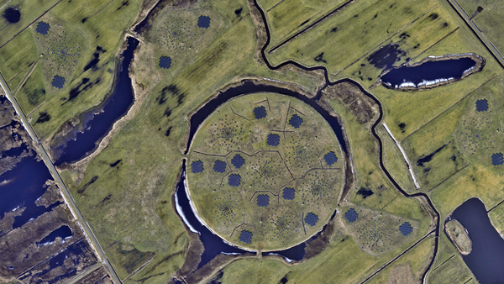
Why turbulence? Why polarization maps?
Interstellar Medium
Typical magnetic field tracing method: synchrotron polarization
Velocity fluctuations
van Weeren et al. (2019)
Density fluctuations
Taurus region
Synchrotron emission
Wittor Denis (2023)
Bonafede et al. (2022)
420 pc
140pc
46.7pc
11.7pc
2.3pc
New radio surveys
Kolmogorov spectrum
Distance (degrees,pc)
LOFAR
large sky coverage,
many wavelengths
Yuen, Ho & AL 2021
Armstrong+ 95;
Chepurnov & AL 09
Kolmogorov spectrum is common in Astrophysics
(star formation, transport, cosmic rays, heating)
Notes:
Turbulence is important in many directions.
It’s important to study the cosmic rays, the accelerations, for star formation.
For all of this is important, because all liquids in astrophysics are turbulent. And turbulence changes all of their properties.
Synchrotron polarization traces magnetic turbulence across scales

Slide 3
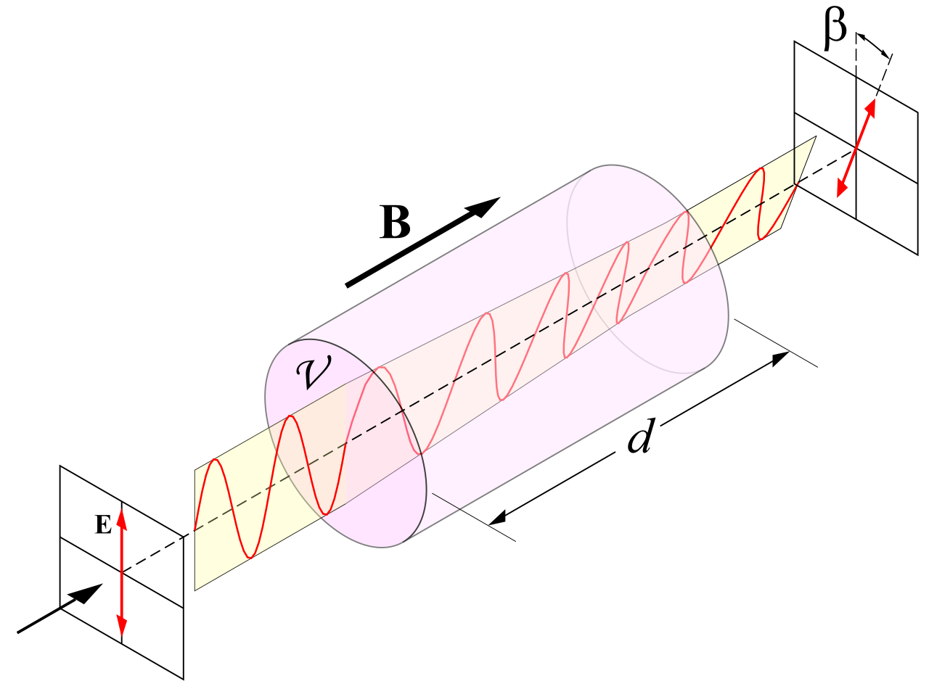

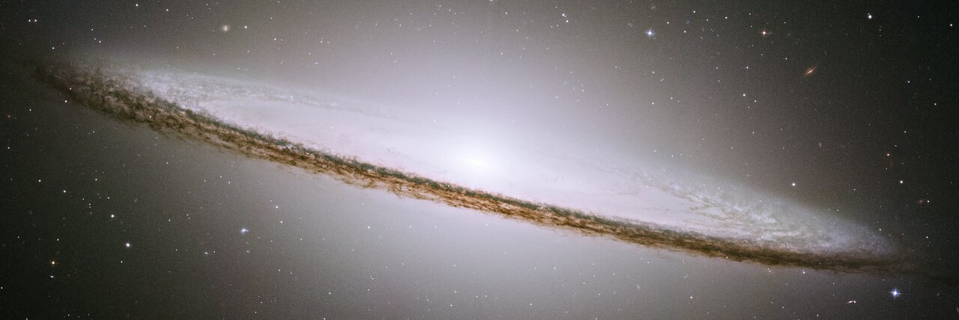
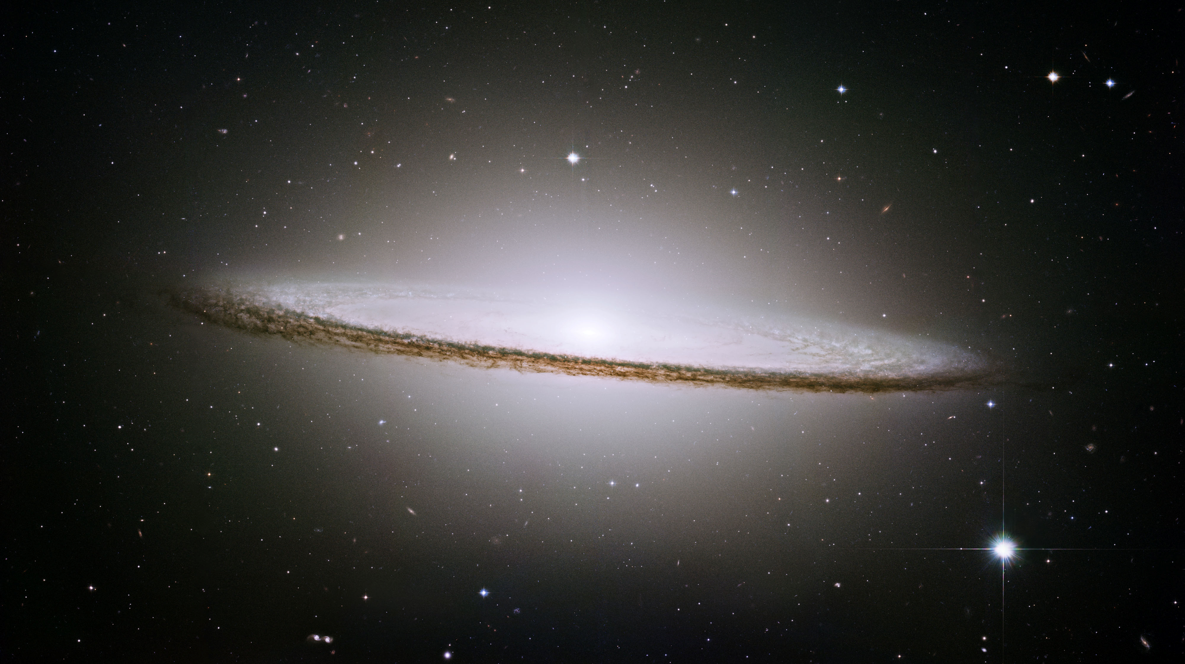
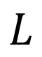
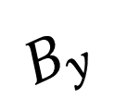
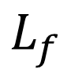
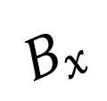
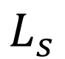
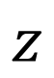
The core problem: intrinsic vs Faraday are mixed
Two sources of fluctuations: (i) intrinsic synchrotron polarization
(ii) Faraday rotation
$$B_{y}$$
$$L_{f}$$
$$B_{x}$$
$$L_{s}$$
observer
LOS
Separated Screens Geometry
$$L$$
Faraday emitting screen
(galaxy disk, ionized part of more dense gas that dominates faraday rotation)
$$z$$
Intrinsic synchrotron screen
(galactic halo; outer parts of the galaxy
where the thermal electron density is low)
Notes:
It is important to distinguish: there is one spectr, and there is another. And studying them separately is important. But when we start to measure, some measures are mixed. Because, of this it is important to emphasize them and separate.
So we suggest a new method of separation. So observers could distinguish what is faraday and what is intristic. And we could estimate the transitional range, and regime, when two effects are mixed.
And the presence of more than one measure allows to more accurately study the separation, and determine what is what.

Slide 4
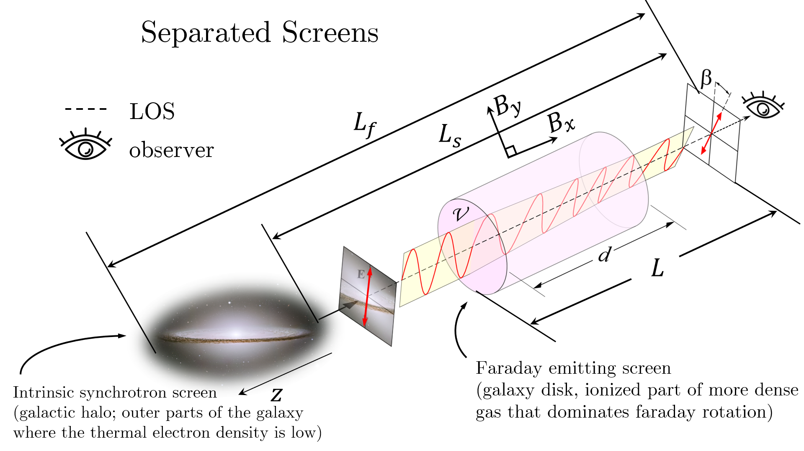
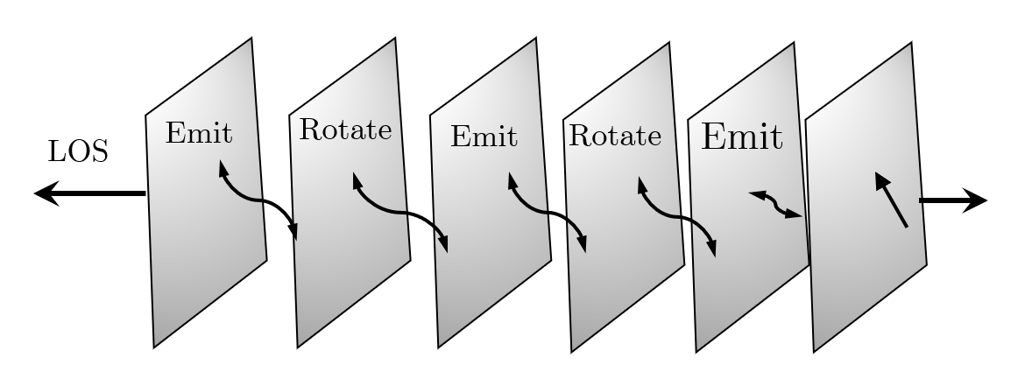
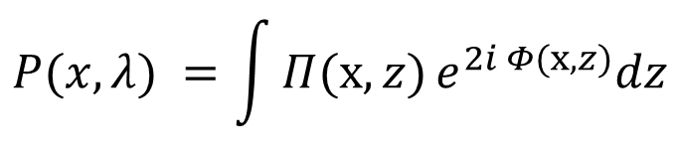
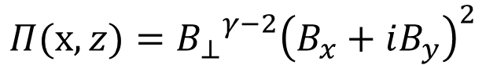

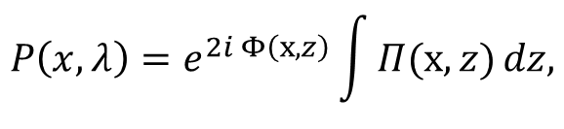
Propagation geometries: separated screen and mixed volume
$$Π(x,z)={{B_{⊥}}^{γ−2}\left(B_{x}+iB_{y}\right)}^{2}$$
With emissivity ($γ=2$):
Separated screen
(external RM screen in front of emitter)
Mixed volume
(emission and rotation in the same region)
$$P\left(x, λ\right)=e^{2i Φ\left(x,z\right)}\int{Π(x,z)}dz,$$
$$P(x, λ) =\int{Π(x,z)}e^{2i Φ(x,z)}dz$$
Notes:
Separated screens are common: halo emission + disk RM screen, or background source + foreground ionized layer
It is important to distinguish: there is one spectr, and there is another. And studying them separately is important. But when we start to measure, some measures are mixed. Because, of this it is important to emphasize them and separate.
So we suggest a new method of separation. So observers could distinguish what is faraday and what is intristic. And we could estimate the transitional range, and regime, when two effects are mixed.
And the presence of more than one measure allows to more accurately study the separation, and determine what is what.

Slide 5
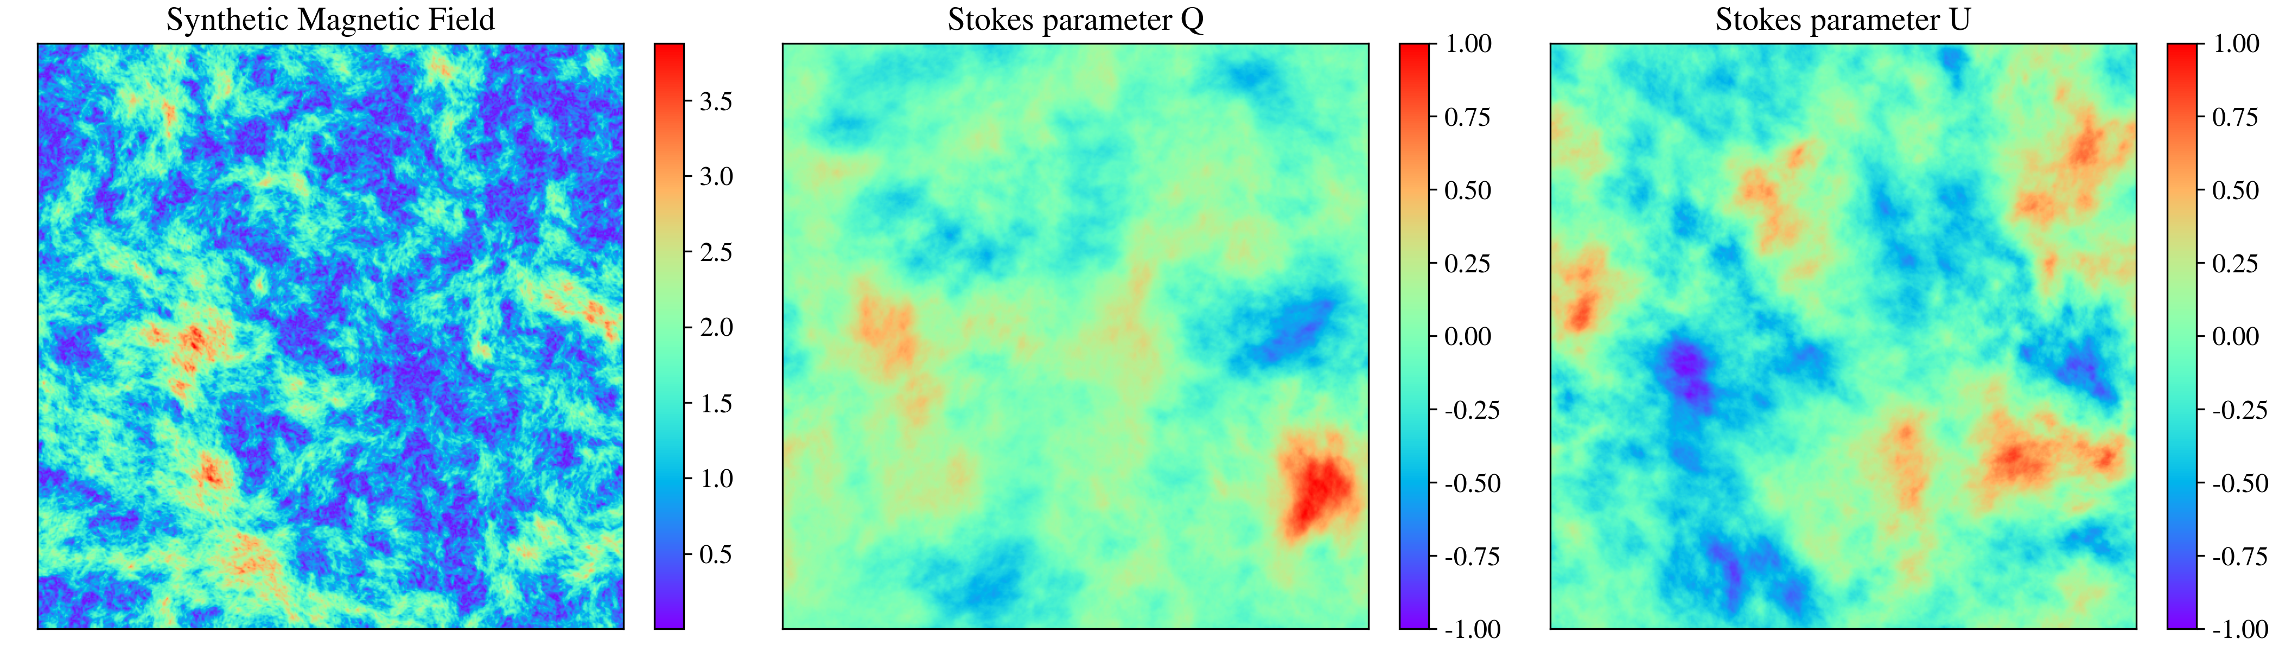
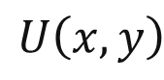
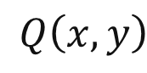
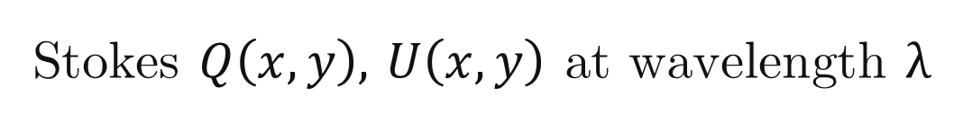
New Measure: Directional Spectrum of $P$
Stokes $Q\left(x,y\right),$ $U\left(x,y\right)$ at wavelength $λ$
Directional spectrum
(2D Fourier power vs direction)
$Q\left(x,y\right)$
$U\left(x,y\right)$
$$P\left(X,λ\right)=Q+iU, D\left(k,λ\right)=\left\langle |\tilde{P}(k,λ)|\right\rangle$$
Practical advantages:
no angle unwrapping
no derivative required
maps directly to spectrum
$$P_{dir}\left(k\right)={|FFT(cos(2χ)|}^{2}+{|FFT(sin(2χ)|}^{2}$$
Notes:
On the other hand, we propose a measure, that doesn’t require the derivative.
It could be occurred directly from Q and U stokes parameters, that are available directly from the observations.

Slide 6
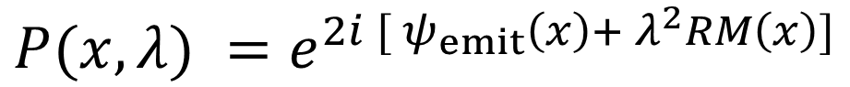
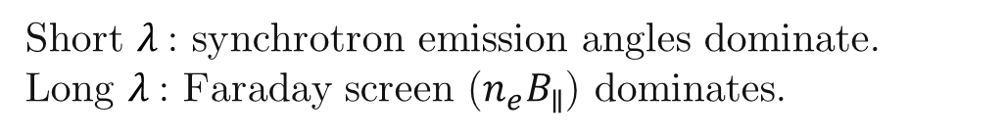
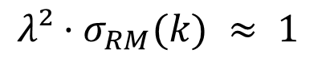
Emission vs. Faraday Screen: who dominates?
Polarization model (external screen):
$$P(x, λ) =e^{2i [ ψ_{emit}\left(x\right)+ λ^{2}RM\left(x\right)]}$$
Transition criterion (at scale k):
$$λ²·σ_{RM}(k) ≈ 1$$
defines crossover $k_{×} (λ)$
Short $λ$: synchrotron emission angles dominate.
Long $λ$: Faraday screen ($n_{e}B_{∥}$) dominates.
Standard Deviation of Rotation Measure
Notes:
1. Initiallly Draw the picture halo, thickness, and so on on the front title 2. here, plot when the dispertion increases (plot the layer, and some вихри) 3. more transition to simulations addres.
“At wavenumber k, the winner is set by a simple rule: when λ² times the RM dispersion at k is about one, the dominance flips. We call the corresponding wavenumber k-cross, and we can measure it from a single map. As λ increases, k-cross slides to smaller k, revealing a clean, predictable transition from synchrotron-dominated to Faraday-dominated structure.”

Slide 7
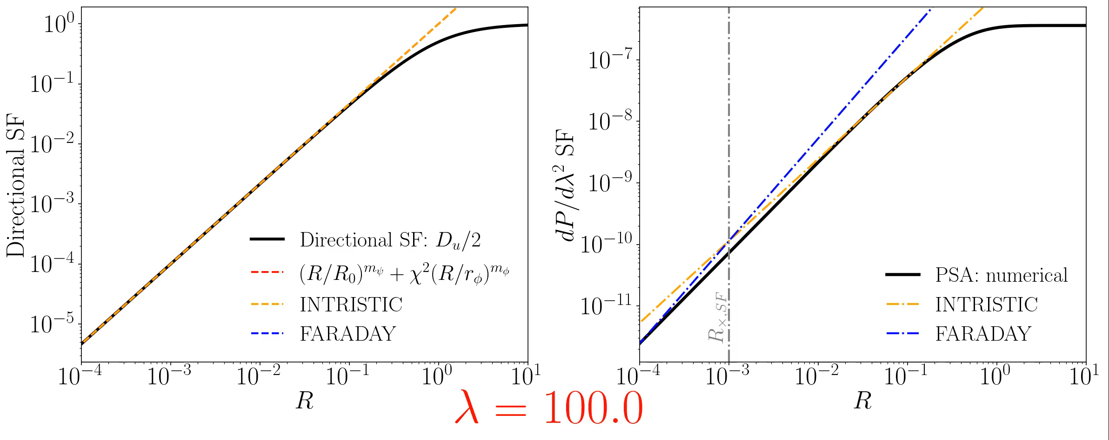
Comparison Directional and $dP/dλ^{2}$ structure functions
New Directional measure shows better correlation for faraday screen!

Slide 8
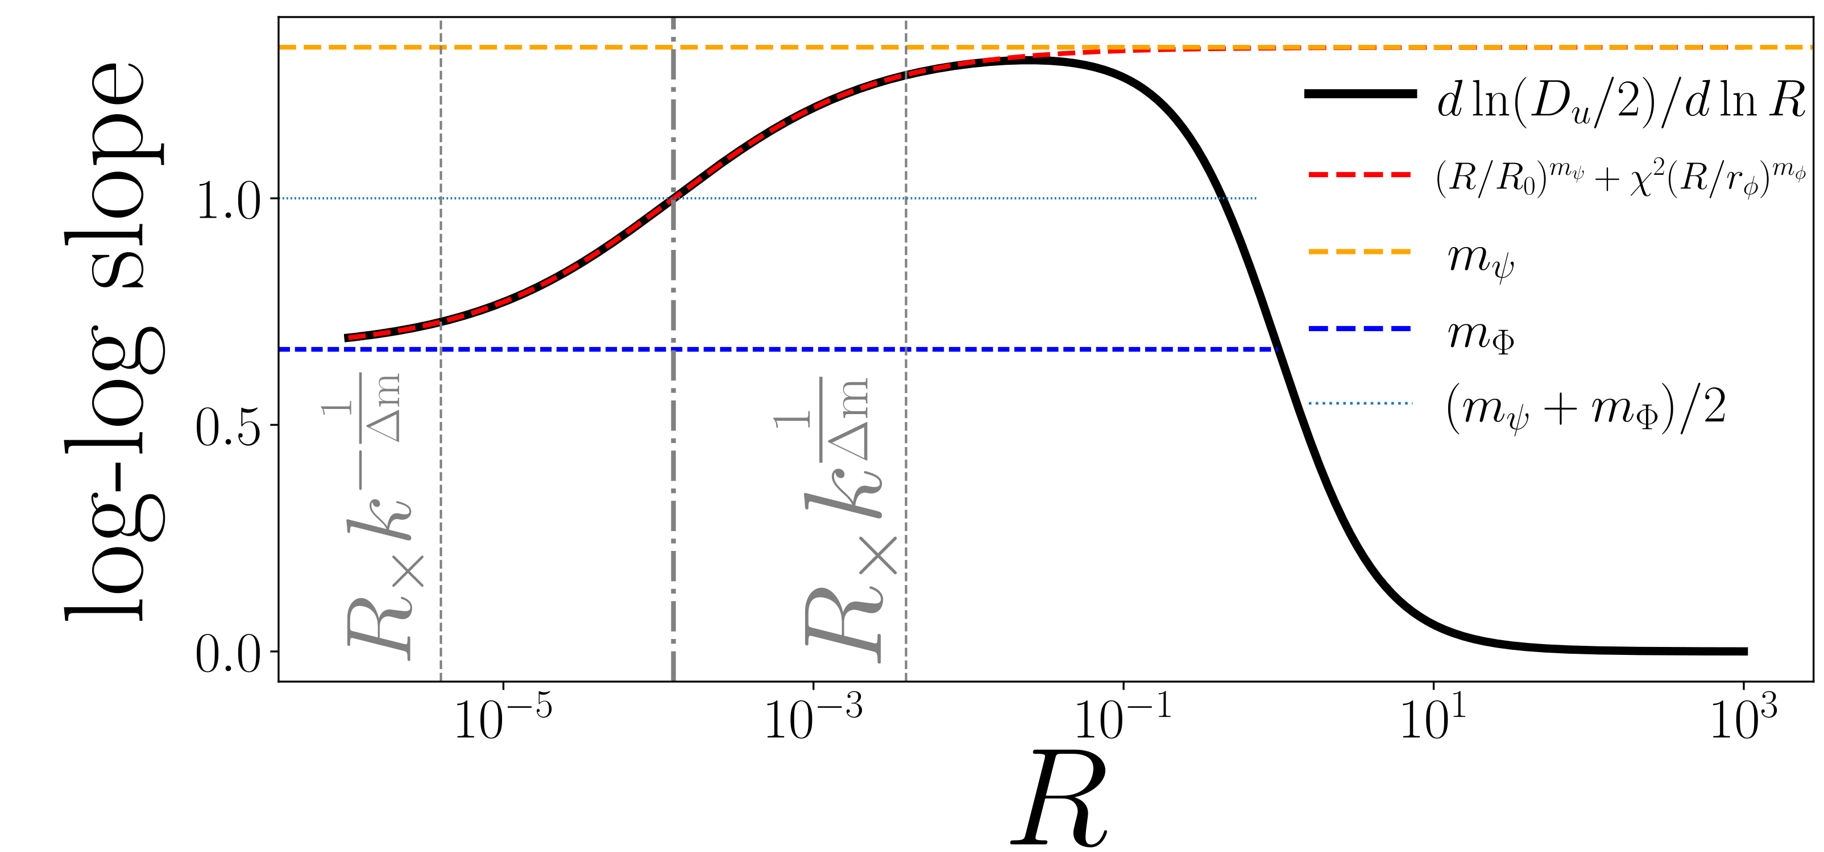
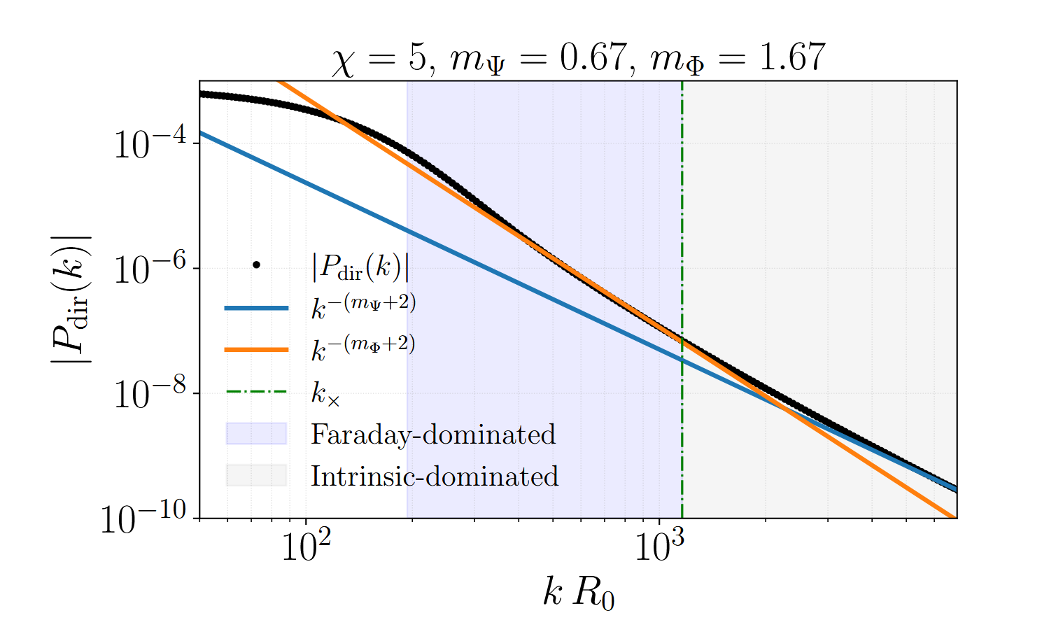
Which regime dominates (instrinstic, faraday, or transitional)?

Slide 9
People already studing the following
It is important to distinguish: there is one spectr, and there is another. And studying them separately is important. But when we start to measure, some measures are mixed. Because, of this it is important to emphasize them and separate.
So we suggest a new method of separation. So observers could distinguish what is faraday and what is intristic. And we could estimate the transitional range, and regime, when two effects are mixed.
And the presence of more than one measure allows to more accurately study the separation, and determine what is what.

Slide 10
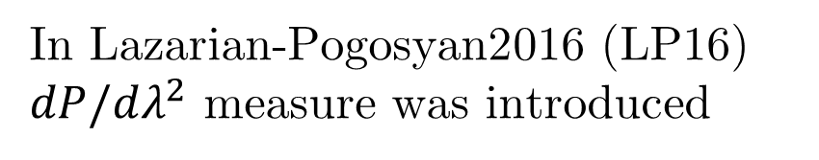
Common diagnostic approaches to Study Turbulence
Scattering (e.g. scintillation, pulse broadening)
Spectral statistics(power spectra, structure functions)
Gradient-based methods
In Lazarian-Pogosyan2016 (LP16)
$dP/dλ^{2}$ measure was introduced
It is disadvantage is that we have to take the derivative
Notes:
title
Planck, sections
Next slide: Faraday, path alternatives
Synchrton as good measure of magnetic field
informant
Magnetic turbulence is ubiquitous in astrophysics
(Armstrong et al. 1995). It shapes star formation (Fed-
errath 2016), angular momentum transport (Balbus &
Hawley 1991), and mediates conductivity and cosmic-
ray propagation (Brandenburg & Lazarian 2013), yet
most observational diagnostics are limited to 2D pro-
jections along the line of sight (LOS) (Elmegreen &
Scalo 2004). Faraday rotation is one of the most widely
used probes of these magnetized plasmas: from Galac-
tic RM grids and pulsars to cluster radio halos and FRBs, it reveals the LOS magnetic field weighted by
the thermal-electron density, and—through its spatial
statistics—encodes the underlying turbulence (e.g., see
the review by Akahori et al. 2018).

Slide 11
How this complementary measures are working?
First of all, we consider the polarization angle fluctuations.
If just the fluctions of angle colmogorov spectrum, the angle fluctuations are given a good Kolmogorov spectrum as well.
BUT. Consider the fluctuations in intristic are Kolmogorov (we are expecting this), but the Faraday screen fluctuations not Kolmogorov.
why? Because the faraday screen fluctuations have two components: magnetic field (mostly kolmogorov) and density (it could be any; in particular, shallow).
Notes:
title
Planck, sections
Next slide: Faraday, path alternatives
Synchrton as good measure of magnetic field
informant
Magnetic turbulence is ubiquitous in astrophysics
(Armstrong et al. 1995). It shapes star formation (Fed-
errath 2016), angular momentum transport (Balbus &
Hawley 1991), and mediates conductivity and cosmic-
ray propagation (Brandenburg & Lazarian 2013), yet
most observational diagnostics are limited to 2D pro-
jections along the line of sight (LOS) (Elmegreen &
Scalo 2004). Faraday rotation is one of the most widely
used probes of these magnetized plasmas: from Galac-
tic RM grids and pulsars to cluster radio halos and FRBs, it reveals the LOS magnetic field weighted by
the thermal-electron density, and—through its spatial
statistics—encodes the underlying turbulence (e.g., see
the review by Akahori et al. 2018).

Slide 12
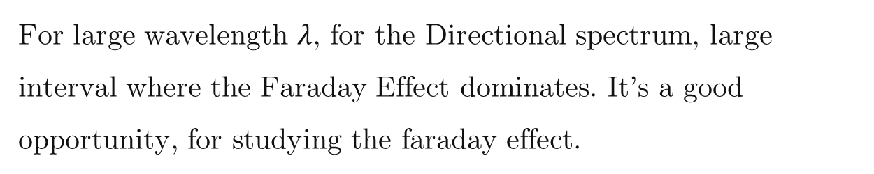
Let’s analyze how those two measure works
For large wavelength $λ$, for the Directional spectrum, large interval where the Faraday Effect dominates. It’s a good opportunity, for studying the faraday effect.
Marijke Haverkorn changed the wavelength – this is a more traditional method.
But we don’t change the wavelength, because of the studying the spectrum.
Thus two measures are complementary. Intristic fluctuations could be measures by styding the non-polarized synchroted – spatial fluctuations give the information about synchrotron screen.
Notes:
title
Planck, sections
Next slide: Faraday, path alternatives
Synchrton as good measure of magnetic field
informant
Magnetic turbulence is ubiquitous in astrophysics
(Armstrong et al. 1995). It shapes star formation (Fed-
errath 2016), angular momentum transport (Balbus &
Hawley 1991), and mediates conductivity and cosmic-
ray propagation (Brandenburg & Lazarian 2013), yet
most observational diagnostics are limited to 2D pro-
jections along the line of sight (LOS) (Elmegreen &
Scalo 2004). Faraday rotation is one of the most widely
used probes of these magnetized plasmas: from Galac-
tic RM grids and pulsars to cluster radio halos and FRBs, it reveals the LOS magnetic field weighted by
the thermal-electron density, and—through its spatial
statistics—encodes the underlying turbulence (e.g., see
the review by Akahori et al. 2018).

Slide 13
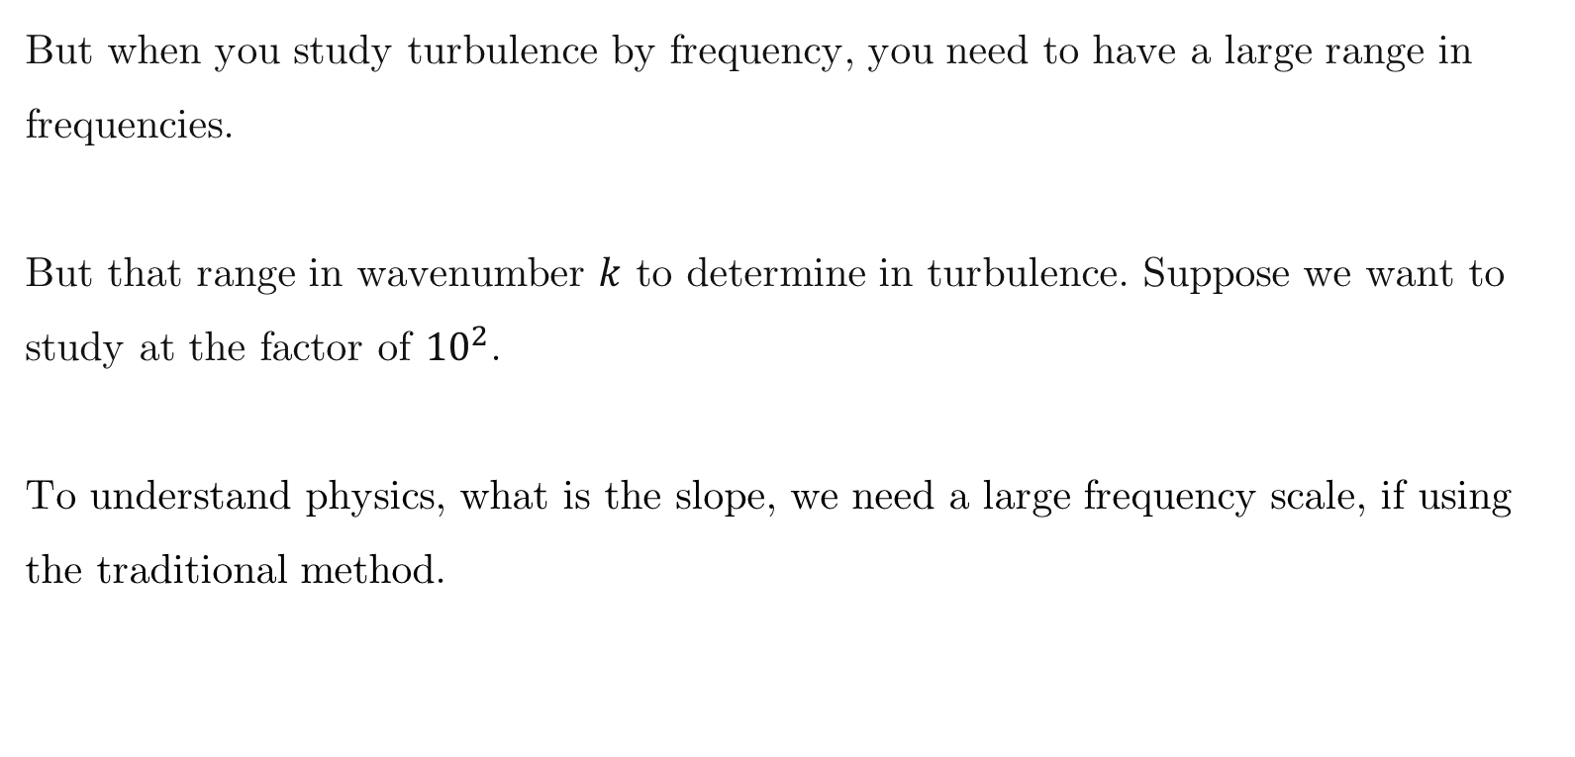
History
This question is huge, and people had studied this for a long period of time [TODO: check literature].
But when you study turbulence by frequency, you need to have a large range in frequencies.
But that range in wavenumber $k$ to determine in turbulence. Suppose we want to study at the factor of ${10}^{2}$.
To understand physics, what is the slope, we need a large frequency scale, if using the traditional method.
Notes:
title
Planck, sections
Next slide: Faraday, path alternatives
Synchrton as good measure of magnetic field
informant
Magnetic turbulence is ubiquitous in astrophysics
(Armstrong et al. 1995). It shapes star formation (Fed-
errath 2016), angular momentum transport (Balbus &
Hawley 1991), and mediates conductivity and cosmic-
ray propagation (Brandenburg & Lazarian 2013), yet
most observational diagnostics are limited to 2D pro-
jections along the line of sight (LOS) (Elmegreen &
Scalo 2004). Faraday rotation is one of the most widely
used probes of these magnetized plasmas: from Galac-
tic RM grids and pulsars to cluster radio halos and FRBs, it reveals the LOS magnetic field weighted by
the thermal-electron density, and—through its spatial
statistics—encodes the underlying turbulence (e.g., see
the review by Akahori et al. 2018).

Slide 14
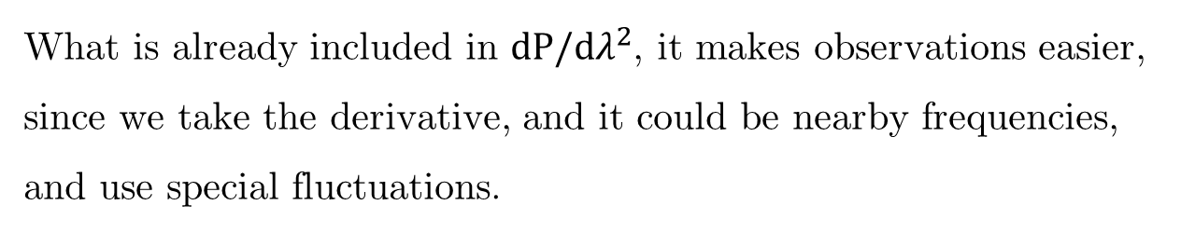
History
What is already included in $dP/dλ^{2}$, it makes observations easier, since we take the derivative, and it could be nearby frequencies, and use special fluctuations.
The using of a new measure, makes the observations easier, and most importantly give a new information.
Notes:
title
Planck, sections
Next slide: Faraday, path alternatives
Synchrton as good measure of magnetic field
informant
Magnetic turbulence is ubiquitous in astrophysics
(Armstrong et al. 1995). It shapes star formation (Fed-
errath 2016), angular momentum transport (Balbus &
Hawley 1991), and mediates conductivity and cosmic-
ray propagation (Brandenburg & Lazarian 2013), yet
most observational diagnostics are limited to 2D pro-
jections along the line of sight (LOS) (Elmegreen &
Scalo 2004). Faraday rotation is one of the most widely
used probes of these magnetized plasmas: from Galac-
tic RM grids and pulsars to cluster radio halos and FRBs, it reveals the LOS magnetic field weighted by
the thermal-electron density, and—through its spatial
statistics—encodes the underlying turbulence (e.g., see
the review by Akahori et al. 2018).

Slide 15
Directional spectrum analysis
We have the asymptotics and we change the parameters
TODO: use not chi but lambda.
Show two three values for lambda.
Notes:
title
Planck, sections
Next slide: Faraday, path alternatives
Synchrton as good measure of magnetic field
informant
Magnetic turbulence is ubiquitous in astrophysics
(Armstrong et al. 1995). It shapes star formation (Fed-
errath 2016), angular momentum transport (Balbus &
Hawley 1991), and mediates conductivity and cosmic-
ray propagation (Brandenburg & Lazarian 2013), yet
most observational diagnostics are limited to 2D pro-
jections along the line of sight (LOS) (Elmegreen &
Scalo 2004). Faraday rotation is one of the most widely
used probes of these magnetized plasmas: from Galac-
tic RM grids and pulsars to cluster radio halos and FRBs, it reveals the LOS magnetic field weighted by
the thermal-electron density, and—through its spatial
statistics—encodes the underlying turbulence (e.g., see
the review by Akahori et al. 2018).

Slide 16
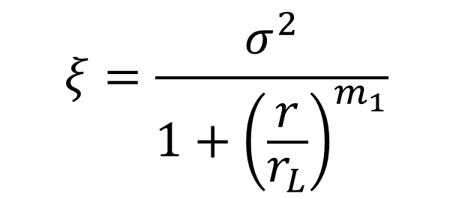
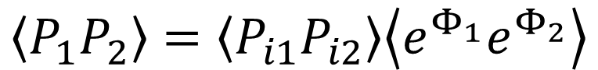

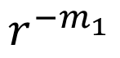
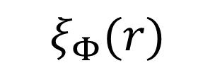
$$\left\langle P_{1}P_{2}\right\rangle =\left\langle P_{i1}P_{i2}\right\rangle \left\langle e^{Φ_{1}}e^{Φ_{2}}\right\rangle$$
$$ξ_{1}(r)$$
$$ξ_{Φ}(r)$$
$$ξ$$
$$r_{1}$$
$$r^{−m_{1}}$$
$$r_{φ}$$
$$ξ=\frac{σ^{2}}{1+{\left(\frac{r}{r_{L}}\right)}^{m_{1}}}$$
$$r_{1}$$

Slide 17
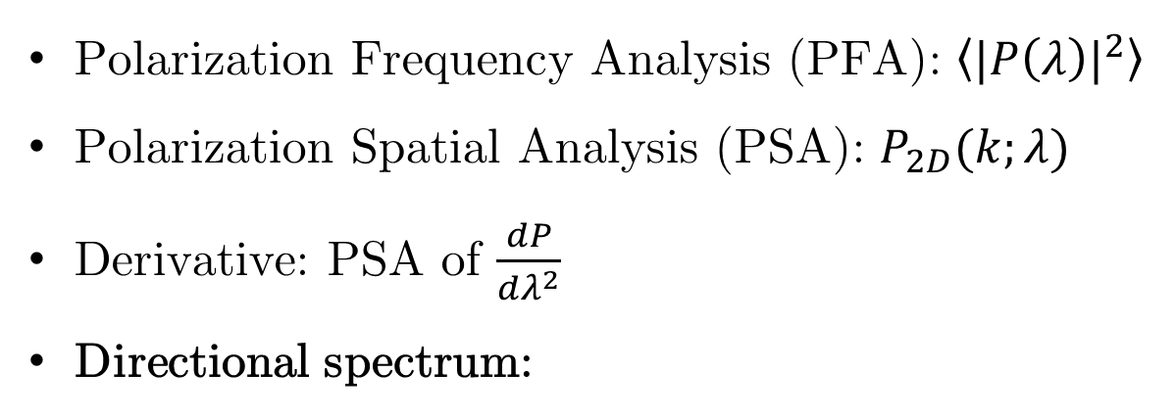
Four complementary measures
Polarization Frequency Analysis (PFA): $\left\langle {|P\left(λ\right)|}^{2}\right\rangle$
Polarization Spatial Analysis (PSA): $P_{2D}(k;λ)$
Derivative: PSA of $\frac{dP}{dλ^{2}}$
Directional spectrum:
LP16
$$P_{dir}\left(k\right)={|FFT(cos(2χ)|}^{2}+{|FFT(sin(2χ)|}^{2}$$

Slide 18
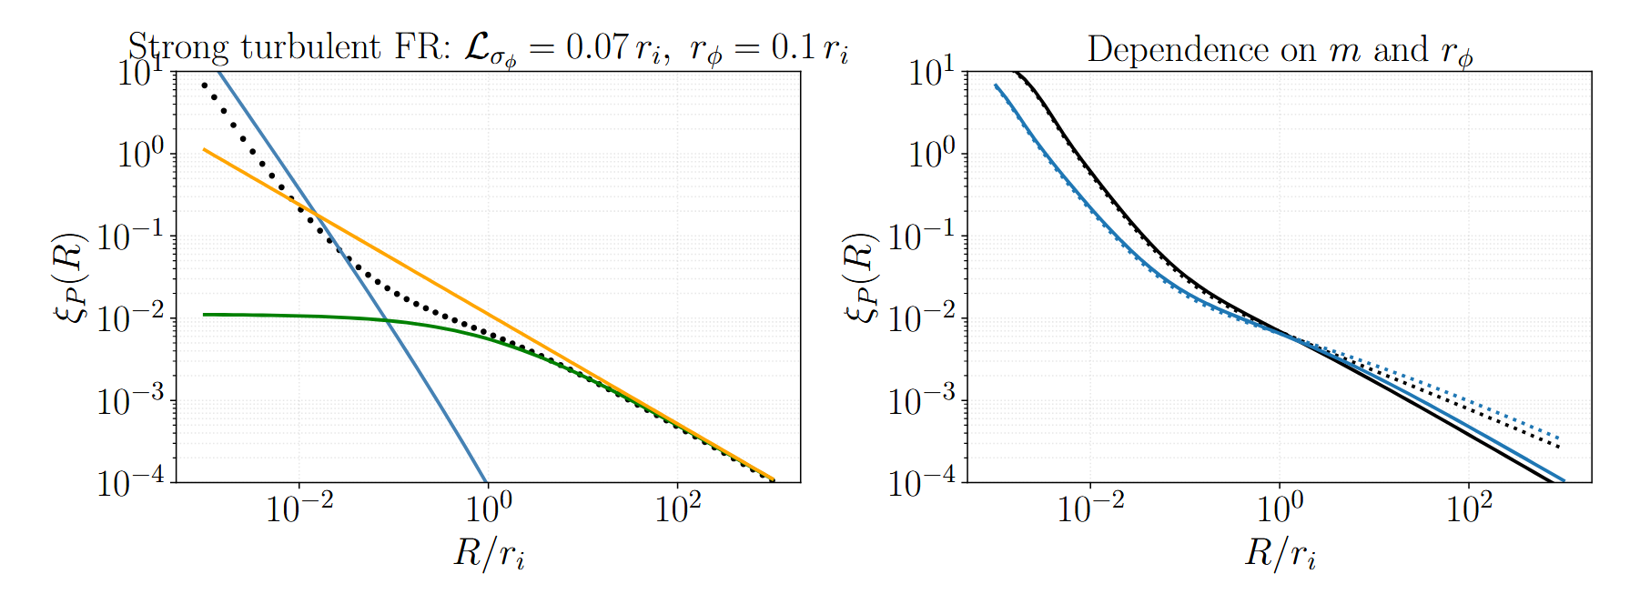

Slide 19
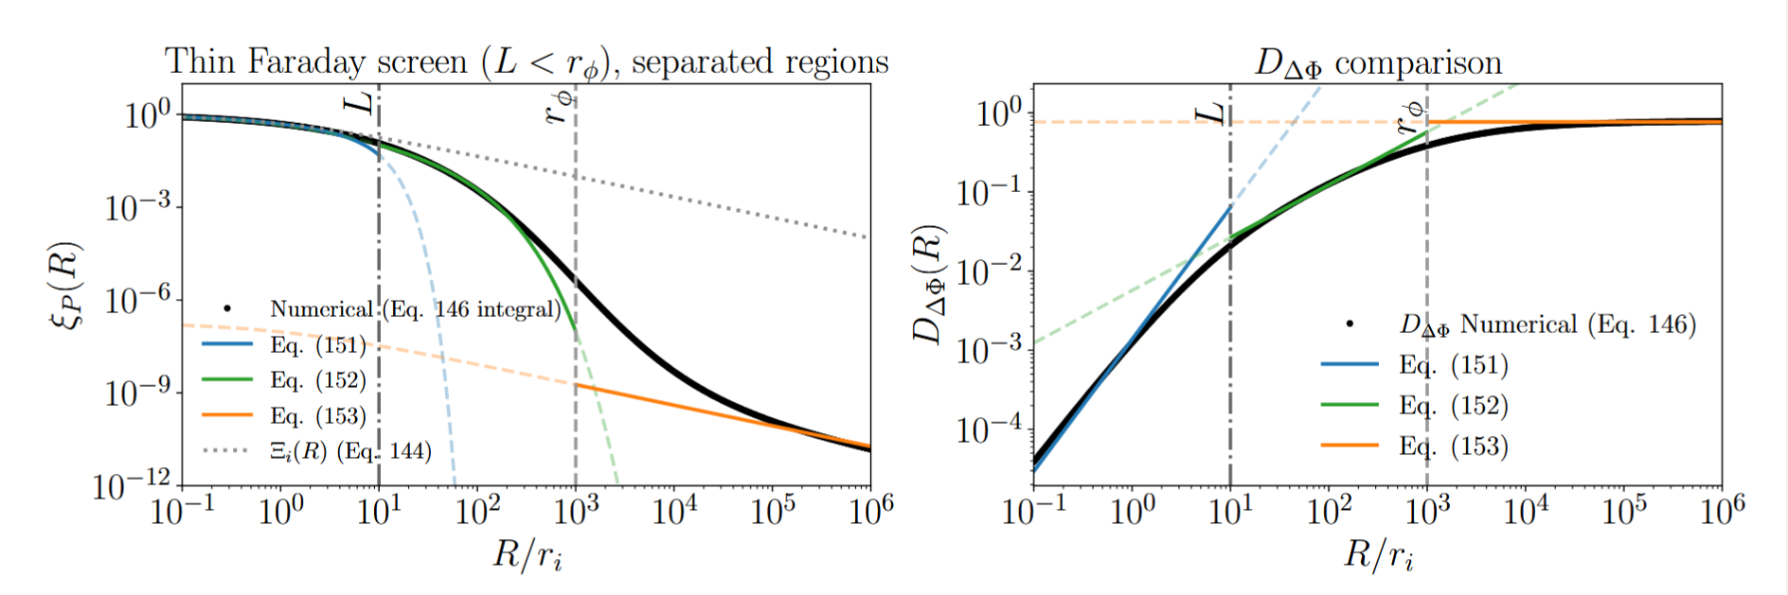

Slide 20
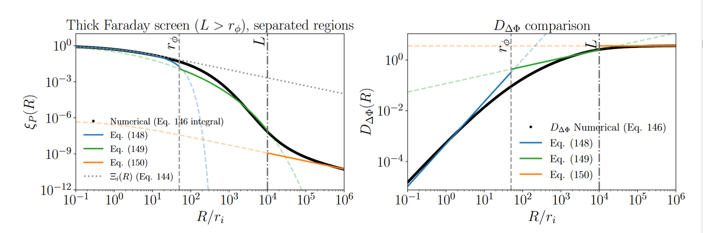

Slide 21
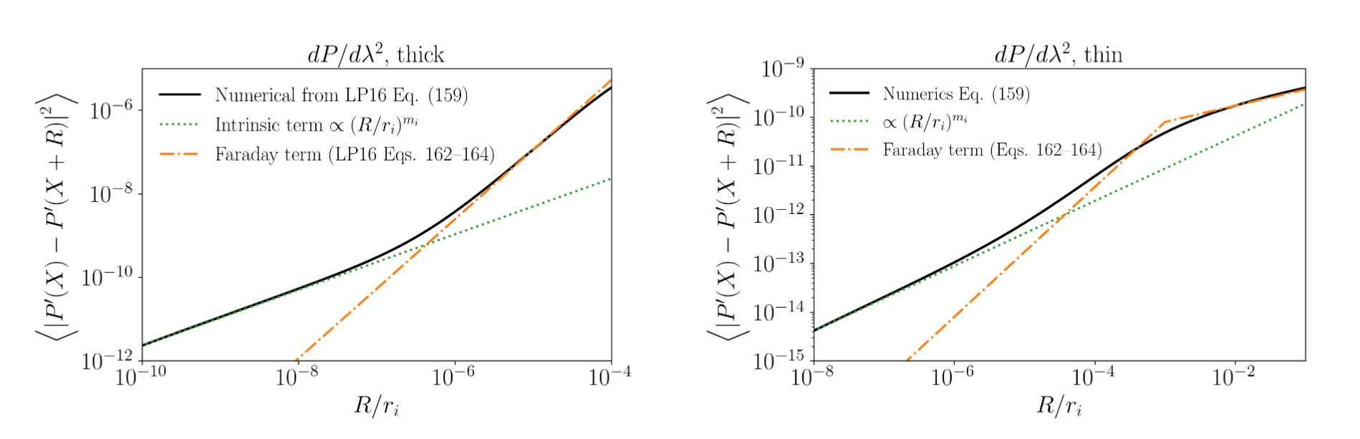

Slide 22
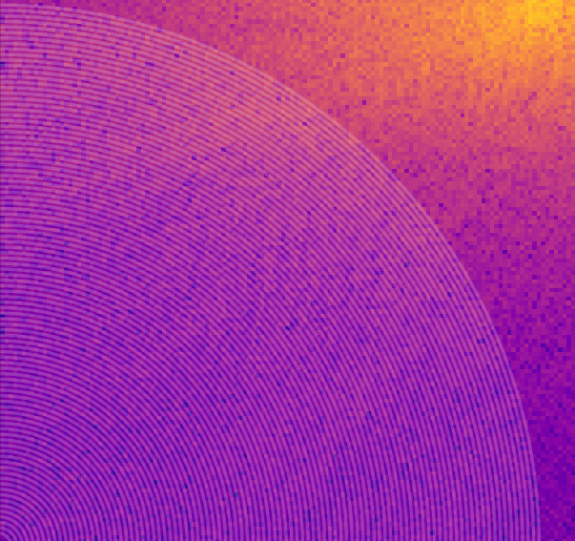
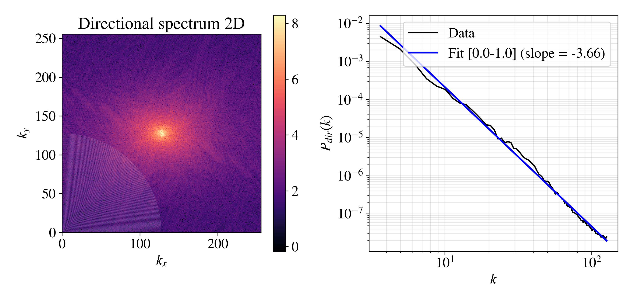
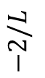



$$λ=0, χ=0$$
$$−3−m_{φ}=−11/3$$
$$−2/L$$
$$−2/L$$

Slide 24


Slide 25



SKA
Directional Spectrum Advantages
We can extract the polarization data
The new measure is new and progressive
Not need to compute derivatives
Use one wavelength only
Using the
LOFAR

Slide 26
A New Turbulence Measure from Multi-frequency Synchrotron Polarization
Recover the turbulence spectrum and anisotropy from polarization maps without RM synthesis.
We introduce a directional-spectrum measure computed directly from Q and U.
Aliaksandr Melnichenka
Berea College
American Astronomical Society (AAS 247)
January 7, 2026
Phoenix, AZ.
Alex Lazarian (UW Madison)
Dmitry Pogosyan (University of Alberta)
Notes:
Names, conference name
“Imagine recovering the spectrum of interstellar magnetic turbulence from just one polarization map at one radio frequency. No RM synthesis. No wide bandwidth. That’s the core result of our work.”

